Slide 1
Friday

Slide 2
Course Logistics
Weekly Activity – Syllabus Quiz Due Monday, January 30
Problem Set 1 – Due Wednesday, February 8
Project Milestone 1 – Due Wednesday, Feb. 1

Slide 3

Project Milestone 1 – Feb. 1
Group Member Names + Team Name
Your group must be no more than 3 people
Motivation
Why is this an important and interesting problem? What triggered the idea?
Data / Data Plan
A description of your data.
This entry must include whether you already have the data
if you don't already have access to your dataset you must discuss how you plan to have the data by the time you give your official pitch (Milestone 2, September 26).
Submit this 0.5 to 2 page report as a PDF or DOC/DOCX

Slide 4
Project – Problem Space
What are you interested in?

Slide 5
Project – Problem Space
What are you interested in? (according to Piazza Introductions)
Sequential problems (economics, time series)
Scientific Domains (medicine, ecology, astronomy)
Outdoor Activities (Hiking, Camping)
Music
Sports
Video Games
Animals

Slide 6
Where to find datasets
Organizations relevant to your problem space
Data.gov – lots of different repositories
NASA, ESA, Satellite projects
UCI Machine Learning Repository
Kaggle
Make sure you’re differentiating yourself from what others have done!
https://github.com/BoulderPublicData/Election-Results

Slide 7
What you should have…
“The Beatles” – John, Paul, George, and Ringo…
You can’t have more than three members though!
We’re interested in modeling music genre…
We have this dataset from Apple Corps with songs and genre labels…

Slide 8


What is an Error?
We’ve looked at trying it out on a test set and getting an “accuracy”
Accuracy = # correct / # total
$$\frac{\sum_{n}^{1}{(y_{i}=={\overline{y}}_{i})}}{n}$$

Slide 9

Types of Errors
Classified As Ground Truth | Cancer | Not Cancer
Cancer | True Positive (Hit) | False Negative (Miss)
Not Cancer | False Positive (False Alarm) | True Negative (Correct Rejection)

Slide 10
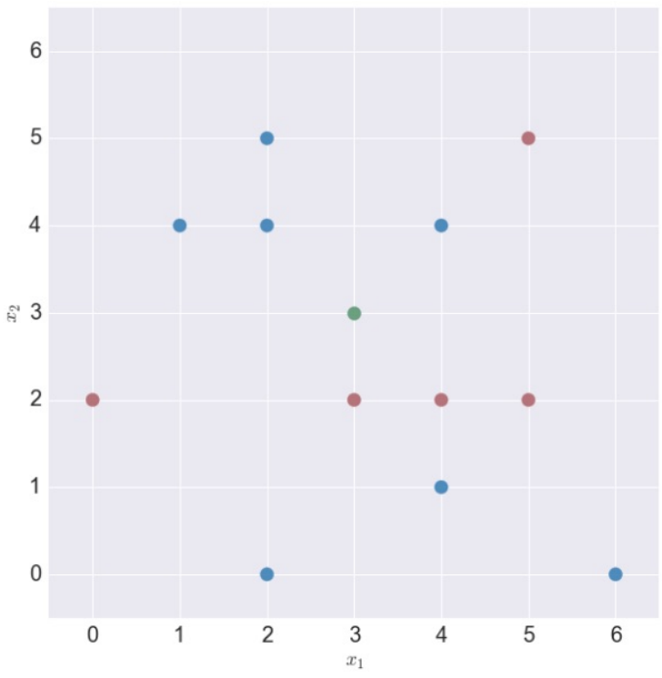
KNN - Regression
0.8
1.7
0.8
1.7
0.4
0.6
1.2
0.4
0.6
1.2
0.3
-2.1
-0.1
0.2
0.6
-2.1
-0.1
0.2
0.6
-0.5
-0.5
-1.5
-1.5
-0.6
-0.6

Slide 11
Regression Error
Accuracy = # correct / # total – Does not capture “close”…

Slide 12
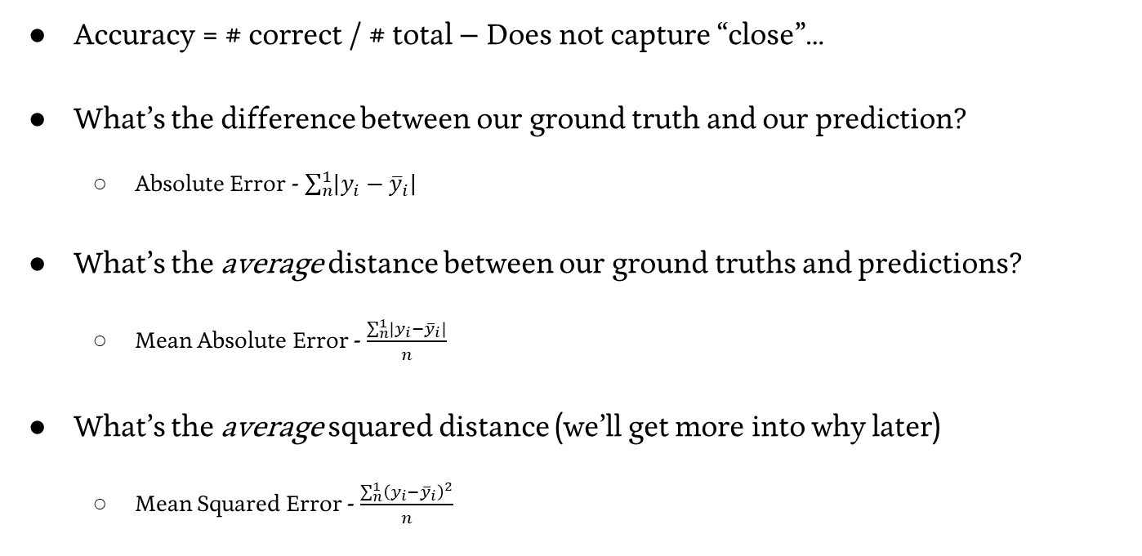

Regression Error
Accuracy = # correct / # total – Does not capture “close”…
What’s the difference between our ground truth and our prediction?
Absolute Error - $\sum_{n}^{1}{\left|y_{i}−{\overline{y}}_{i}\right|}$
What’s the average distance between our ground truths and predictions?
Mean Absolute Error - $\frac{\sum_{n}^{1}{\left|y_{i}−{\overline{y}}_{i}\right|}}{n}$
What’s the average squared distance (we’ll get more into why later)
Mean Squared Error - $\frac{\sum_{n}^{1}{{\left(y_{i}−{\overline{y}}_{i}\right)}^{2}}}{n}$

Slide 13
Decision Trees

Slide 14
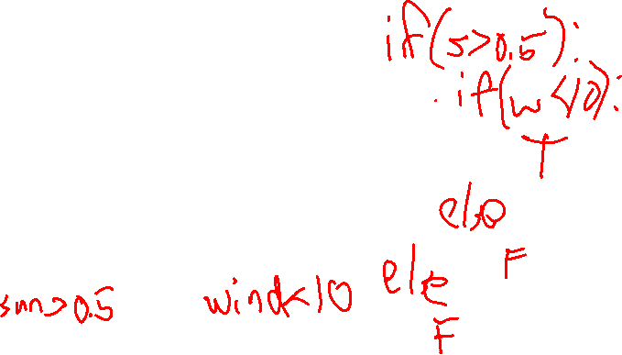
Machine Decision Making - 101
Think back to your very first days of programming…
I ask you to have a program take in two pieces of information:
- sun
- wind
And output whether or not I am going to play tennis.
- Only if it’s sunny and not too windy
What does this program look like?

Slide 15
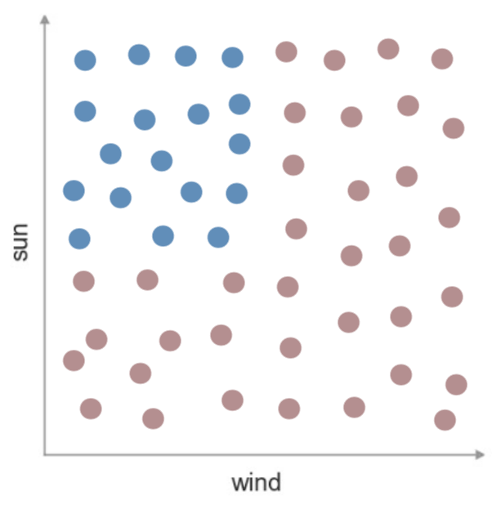
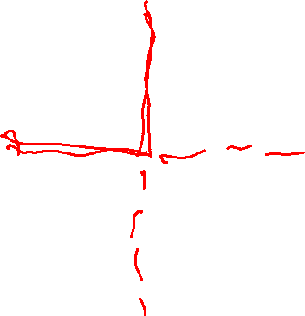
Machine Decision Making - Tennis
Consider this visualization of my data
And our model of a predictor
What would the decision boundary look
like here?

Slide 16

Machine Decision Making - 201
Think back to your very second days of programming (i.e. data structures)…
How might we represent a series of nested if/else statements?

Slide 17
Decision Trees
Creating nonlinear decision boundaries via the union of multiple linear decision boundaries
These are the basis of a lot of more complex algorithms – Stay Tuned

Slide 18
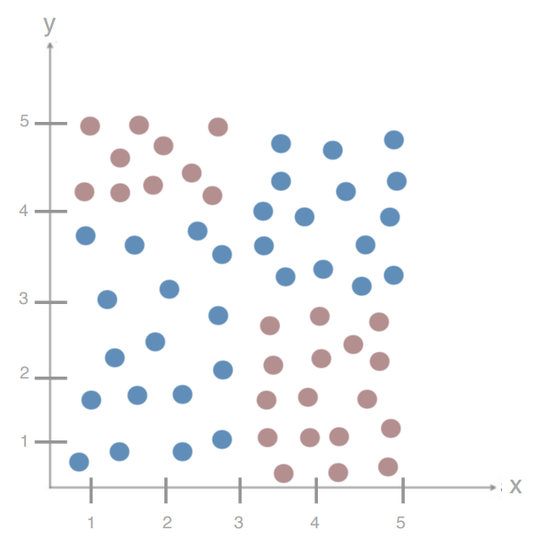
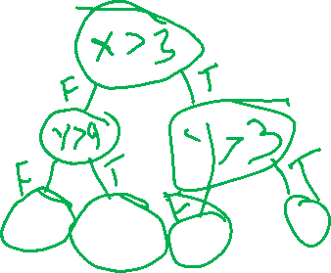
Decision Trees – Adding Complexity
What is my Decision Tree for this dataset?

Slide 19
Decision Trees – Adding Complexity
What is my Decision Tree for this dataset?

Slide 20
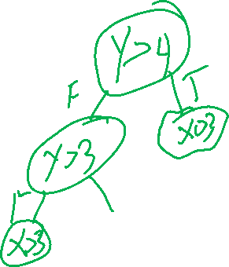
Decision Trees – Adding Complexity
What happens if I split on Y first?

Slide 21
Decision Trees – Adding Complexity
How do we decide the order of our splits?
How do we decide the location of splits?
With continuous variables?
How do we know we’re done?

Slide 22
Decision Trees – Choosing your Split
Simplifying our problem space – binary features
Test A | Test B | Test C | Cancer?
Pos | Neg | Neg | No
Pos | Pos | Neg | No
Neg | Pos | Pos | Yes
Pos | Neg | Pos | Yes

Slide 23
Decision Trees – Choosing your Split
What feature should I split on first?
Test A | Test B | Test C | Cancer?
Pos | Neg | Neg | No
Pos | Pos | Neg | No
Neg | Pos | Pos | Yes
Pos | Neg | Pos | Yes

Slide 24
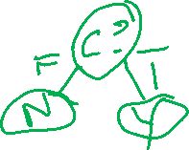
Decision Trees – Choosing your Split
What feature should I split on first?
What is my entire tree?
Test A | Test B | Test C | Cancer?
Pos | Neg | Neg | No
Pos | Pos | Neg | No
Neg | Pos | Pos | Yes
Pos | Neg | Pos | Yes

Slide 25
Decision Trees – Finding the Best Split
We need to find the split that gives us the best arrangement
We need to find the split that creates the most order from our chaos
We need to find the split that minimizes our impurity.
Test A | Test B | Test C | Cancer?
Pos | Neg | Neg | No
Pos | Pos | Neg | No
Neg | Pos | Pos | Yes
Pos | Neg | Pos | Yes

Slide 26
Decision Trees - Entropy
A measure of the impurity / messiness / chaos of a set of examples

Slide 27
Decision Trees - Entropy
A measure of the impurity / messiness / chaos of a set of examples
∑_{c=1…n} -p_{c} * log₂(p_{c})

Slide 28
Decision Trees - Entropy
A measure of the impurity / messiness / chaos of a set of examples
∑_{c=1…n} [-p_{c} * log₂(p_{c})]
C for each possible class
In the binary case…
-p * log₂(p) – (1-p) * log₂(1-p)

Slide 29
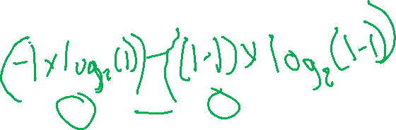
Decision Trees - Entropy
A measure of the impurity / messiness / chaos of a set of examples
Entropy = ∑_{c=1…n} [-p_{c} * log₂(p_{c})]
C for each possible class
In the binary case…
Entropy = -p * log₂(p) – (1-p) * log₂(1-p)
What happens at p = 1? p = 0? p = 0.5?

Slide 30
Decision Trees - Entropy
A measure of the impurity / messiness / chaos of a set of examples
Entropy = ∑_{c=1…n} [-p_{c} * log₂(p_{c})]
C for each possible class
In the binary case…
Entropy = -p * log₂(p) – (1-p) * log₂(1-p)
What happens at p = 1? p = 0? p = 0.5?
Minimum – perfect isolation of one class, Entropy = 0
Maximum – perfect split of data, Entropy = 1

Slide 31
Decision Trees - Entropy
A measure of the impurity / messiness / chaos of a set of examples
Entropy = ∑_{c=1…n} [-p_{c} * log₂(p_{c})]
C for each possible class
In the general case… (3 class case)
P_{c} = .33 for all c P = {1,0,0}
Entropy is maximized (~ 1.56) Entropy is 0
P₁ = .4 P₂ = .4 P₃ = .2
Entropy is reduced (~1.52)

Slide 32
Decision Trees – Entropy of Cancer
Entropy of our root node?
Test A | Test B | Test C | Cancer?
Pos | Neg | Neg | No
Pos | Pos | Neg | No
Neg | Pos | Pos | Yes
Pos | Neg | Pos | Yes

Slide 33
Decision Trees – Entropy of Cancer
Entropy of our root node?
-.5 * log₂(.5) - .5 * log₂(.5) = 1
Maximum Entropy
Test A | Test B | Test C | Cancer?
Pos | Neg | Neg | No
Pos | Pos | Neg | No
Neg | Pos | Pos | Yes
Pos | Neg | Pos | Yes

Slide 34
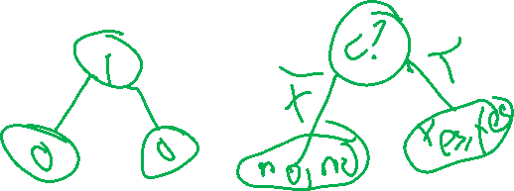
Decision Trees – Entropy of Cancer
How do we pick our split?
Choose the feature that reduces our entropy the most!
Test A | Test B | Test C | Cancer?
Pos | Neg | Neg | No
Pos | Pos | Neg | No
Neg | Pos | Pos | Yes
Pos | Neg | Pos | Yes

Slide 35
Decision Trees – Minimizing Entropy
We are creating a split to minimize the entropy of our set…

Slide 36
Decision Trees – Minimizing Entropy
We are creating a split to minimize the entropy of our set…
But really, we’re creating two sets, each with their own entropy, but a smaller number of samples in each.

Slide 37

Decision Trees – Minimizing Entropy
We are creating a split to minimize the entropy of our set…
But really, we’re creating two sets, each with their own entropy, but a smaller number of samples in each.
Is it better to split evenly, or finely?

Slide 38
Decision Trees – Minimizing Entropy
We are creating a split to minimize the entropy of our set…
But really, we’re creating two sets, each with their own entropy, but a smaller number of samples in each.
What makes for a good split?

Slide 39
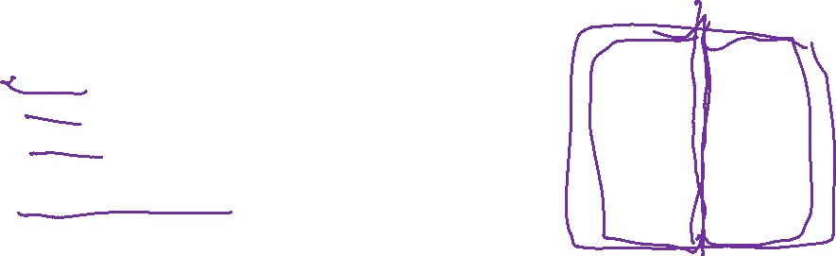
Decision Trees – Minimizing Entropy
We are creating a split to minimize the entropy of our set…
But really, we’re creating two sets, each with their own entropy, but a smaller number of samples in each.
D_{par} = Data found in Parent Node
D_{left} = Data found in Left Node
D_{right} = Data found in Right Node
I() = Impurity function (entropy)
x_{i} = feature for split

Slide 40
Decision Trees – Minimizing Entropy
We are creating a split to minimize the entropy of our set…
But really, we’re creating two sets, each with their own entropy, but a smaller number of samples in each.
D_{par} = Data found in Parent Node
D_{left} = Data found in Left Node
D_{right} = Data found in Right Node
I() = Impurity function (entropy)
x_{i} = feature for split

Slide 41
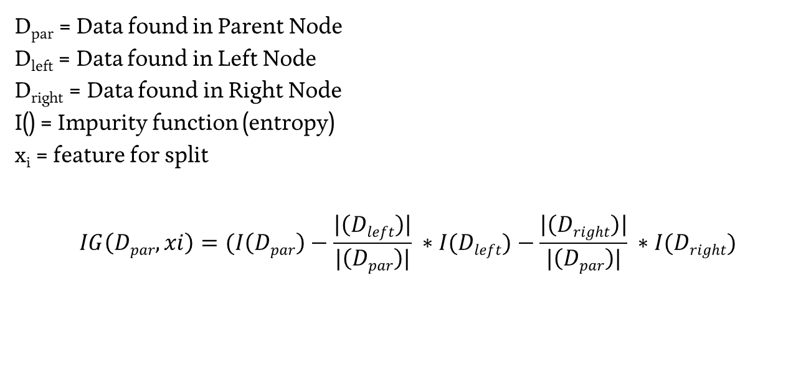
Decision Trees – Information Gain
D_{par} = Data found in Parent Node
D_{left} = Data found in Left Node
D_{right} = Data found in Right Node
I() = Impurity function (entropy)
x_{i} = feature for split
$$IG\left(Dpar,xi\right)=(I\left(Dpar\right)−\frac{\left|\left(Dleft\right)\right|}{|\left(Dpar\right)|} ∗I(Dleft)−\frac{\left|\left(Dright\right)\right|}{|\left(Dpar\right)|} ∗I(Dright)$$

Slide 42

Decision Trees – Choosing a Split
$$IG\left(Dpar,xi\right)=I\left(Dpar\right)−\frac{\left|\left(Dleft\right)\right|}{\left|\left(Dpar\right)\right|} ∗I(Dleft)−\frac{\left|\left(Dright\right)\right|}{\left|\left(Dpar\right)\right|} ∗I(Dright)$$
Split based on the feature x_{i} with the highest Information Gain!

Slide 43
Decision Trees – Splitting Cancer
Compute the IG for a split on each feature, find the maximum
Test A | Test B | Test C | Cancer?
Pos | Neg | Neg | No
Pos | Pos | Neg | No
Neg | Pos | Pos | Yes
Pos | Neg | Pos | Yes

Slide 44


Decision Trees – Splitting Cancer
$$IG\left(Dpar,TA\right)=(I\left(Dpar\right)−\frac{\left|\left(Dleft\right)\right|}{\left|\left(Dpar\right)\right|} ∗I(Dleft)−\frac{\left|\left(Dright\right)\right|}{\left|\left(Dpar\right)\right|} ∗I(Dright)$$
D_{par} = | D_{par} | = I(D_{par}) =
D_{left} = | D_{left} | = I(D_{left}) =
D_{right} = | D_{right} | = I(D_{right}) =
Test A | Test B | Test C | Cancer?
Pos | Neg | Neg | No
Pos | Pos | Neg | No
Neg | Pos | Pos | Yes
Pos | Neg | Pos | Yes

Slide 45
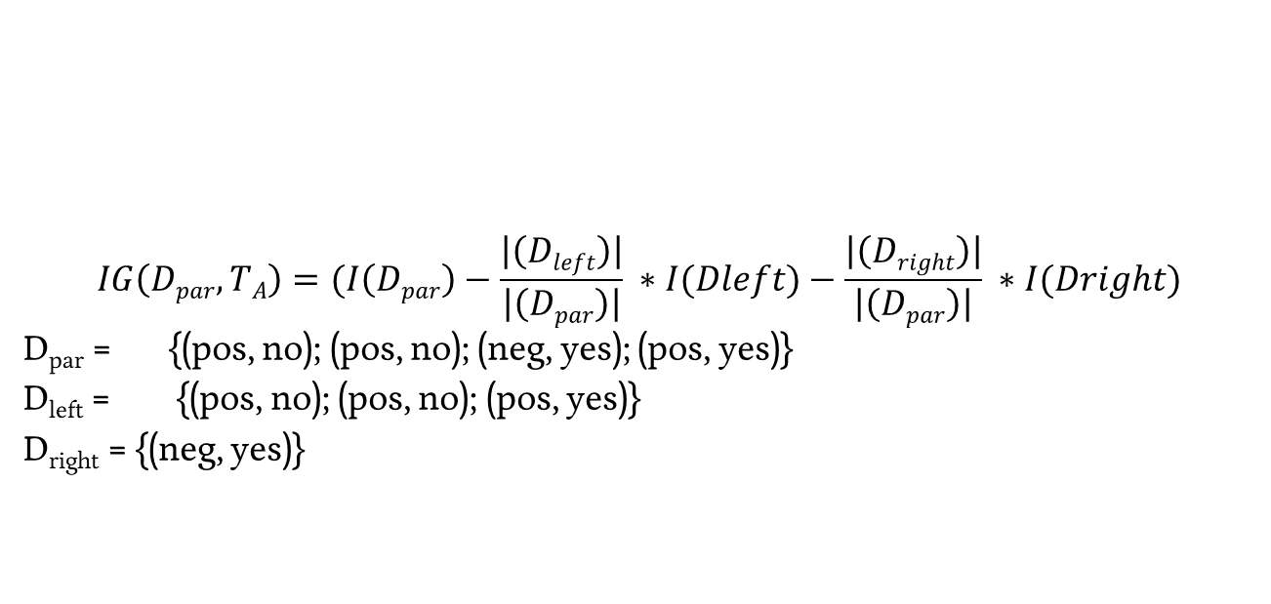

Decision Trees – Splitting Cancer
$$IG\left(Dpar,TA\right)=(I\left(Dpar\right)−\frac{\left|\left(Dleft\right)\right|}{\left|\left(Dpar\right)\right|} ∗I(Dleft)−\frac{\left|\left(Dright\right)\right|}{\left|\left(Dpar\right)\right|} ∗I(Dright)$$
D_{par} = {(pos, no); (pos, no); (neg, yes); (pos, yes)}
D_{left} = {(pos, no); (pos, no); (pos, yes)}
D_{right} = {(neg, yes)}
Test A | Test B | Test C | Cancer?
Pos | Neg | Neg | No
Pos | Pos | Neg | No
Neg | Pos | Pos | Yes
Pos | Neg | Pos | Yes

